Slide 1
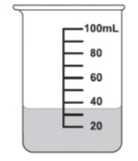

-PROBABILITY- Interactive Notebook
Name
Class
Teacher
Term 4 Semester 2
1

Slide 2
Contents
Glossary or Formula Page
Page
Date
Description
2
3

Slide 3
Tasks
24
7
30
Essential Question
Questions
Notes
Summary
4
5

Slide 4
24
7
30 Venn Diagrams
Date
EQ – What does a Venn diagram look like?
A Venn diagram is
a pictorial representation of
a two-way table without
the total row and total column.
A two way table can be written as a Venn diagram as
5

Slide 5
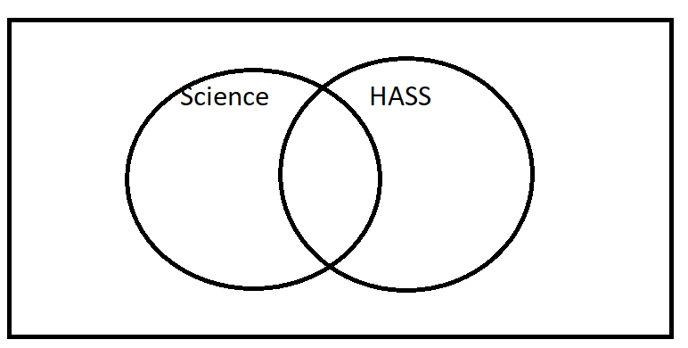
2way to Venn (copy into your notes)
 | Like Science | Do not like Science | Total
Like HASS | 28 | 33 | 61
Do not like HASS | 5 | 34 | 39
Total | 33 | 67 | 100
Notes:
Fill in the Venn diagram with the class explaining where each of the numbers go

Slide 6
What does the overlap represent?
Those who enjoy both. 28
What does the outside area mean?
Those who enjoy Neither. 34
There are only 4 numbers needed in a 2-circle Venn diagram = 4 Probabilities

Slide 7
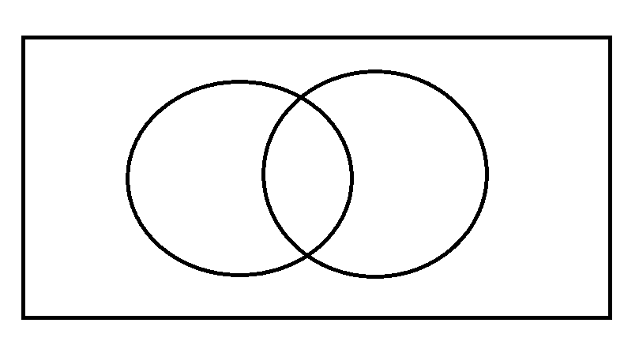
Draw the VENN diagram for…
In a class of 30 students there are 20 students who like Maths, 15 who like English and 12 who like both.

Slide 8
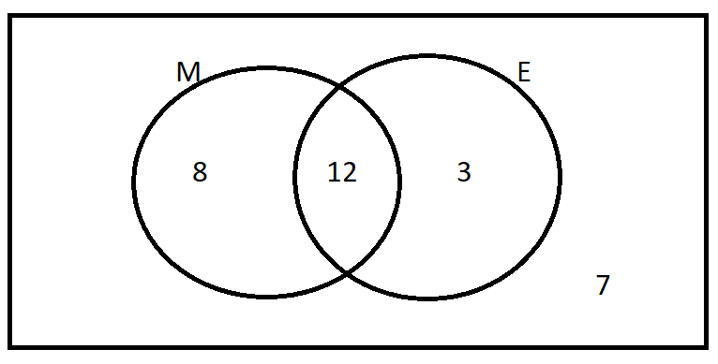
Answer

Slide 9
Use you VENN diagram
How many only like Math?
How many only like English?
How many don’t like either?

Slide 10
LHS
EASY Dwyer p.247 Ex, 18.2 Qns 1-3
MEDIUM. Dwyer p.252 Ex. 18.9 Qns 1-8
HARD. P. 500, q 12-13. Algebraic Venns & 2-way tables.
ENRICHMENT- Triple Venns…p. 501 Cambridge Essentials.

